Slide 1
3D Image Segmentation and Quantification of Lysosomes
Comparison manual.VS. automatic
4/12/2025

Slide 2
FILES
TMEM-HA 6h CB airy_3_170722
40A_UAS-TMEM192-3xHA x 40A 71G10 MARCM_around 12h - for quantification_4 Airy-CBs_300425
40A_UAS-TMEM192-3xHA x 40A 71G10 MARCM_around 12h - for quantification_3 Airy-CBs_300425
40A_UAS-TMEM1923x-HA x 71G10 40A MARCM_L3_1_Airy_010724

Slide 3
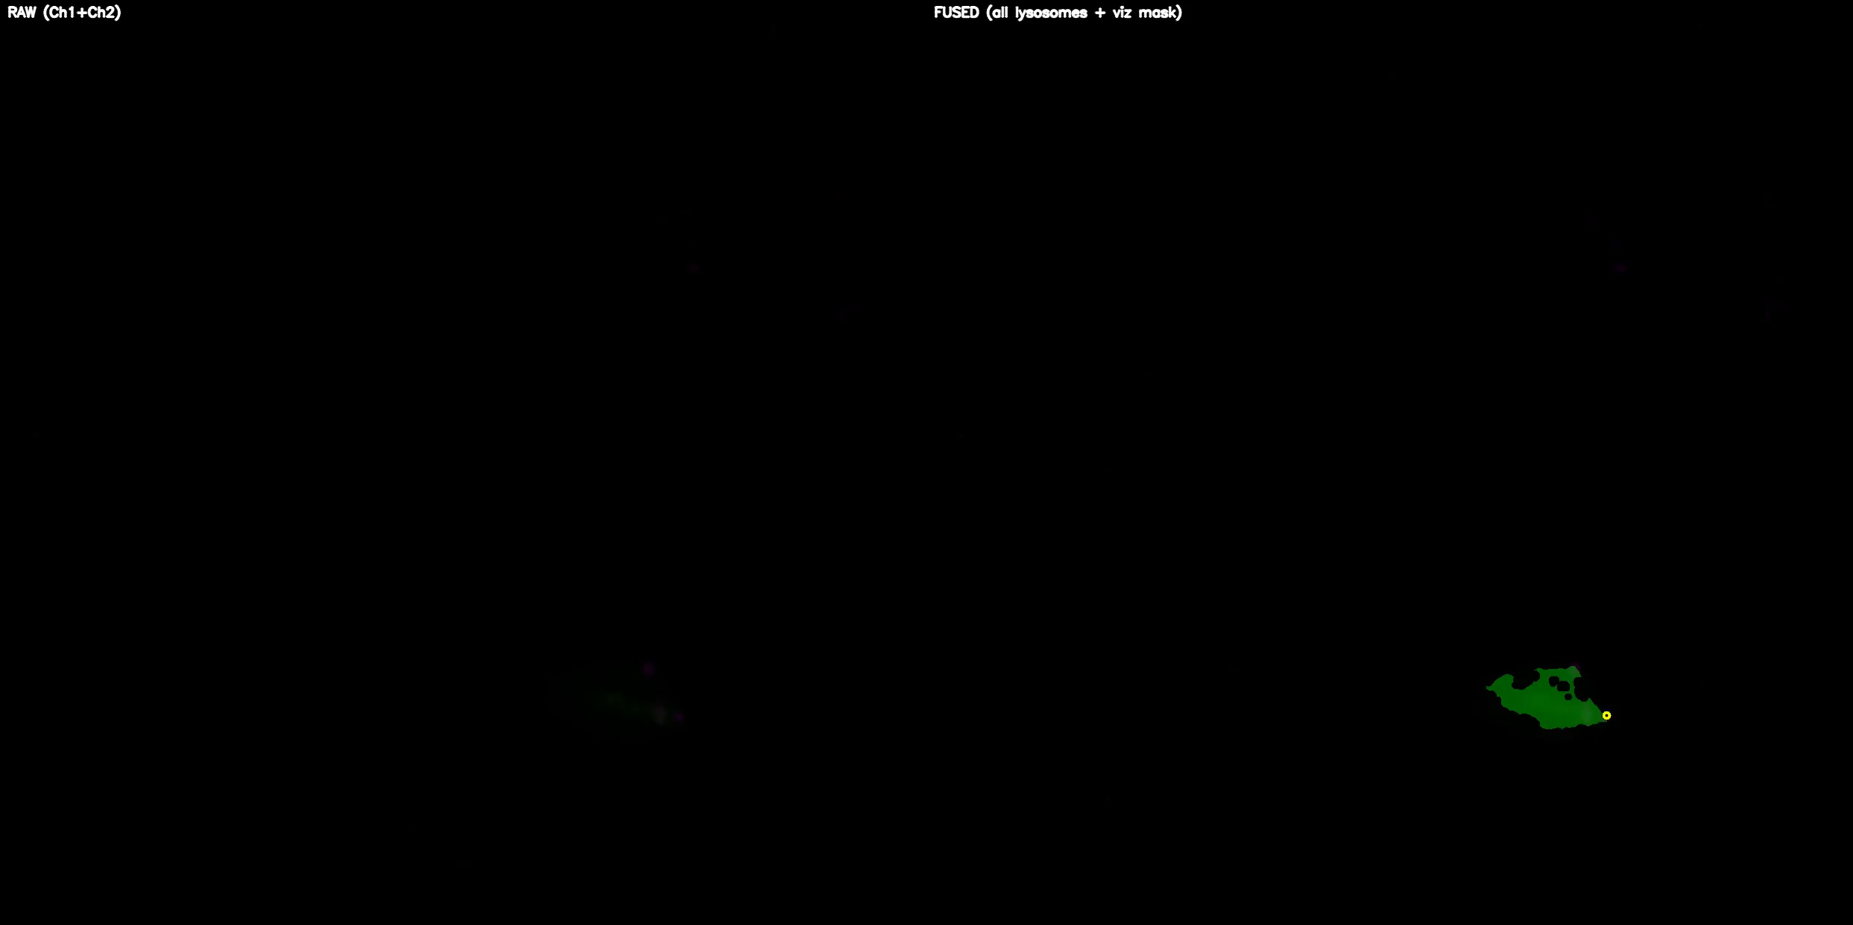
TMEM-HA 6h CB airy_3_170722

Slide 4
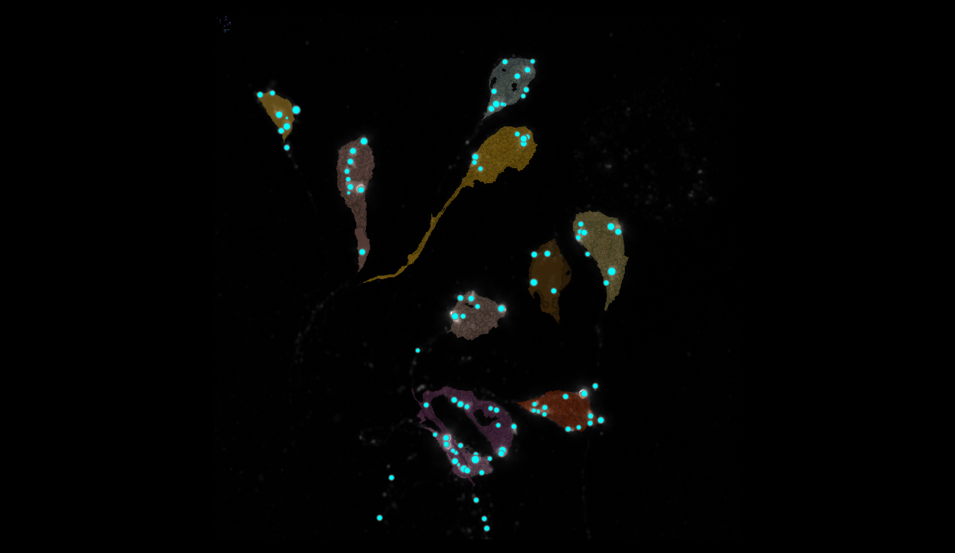
TMEM-HA 6h CB airy_3_170722

Slide 5
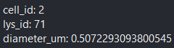
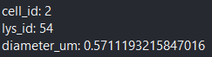
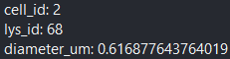
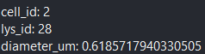
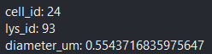
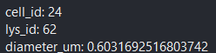
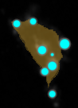
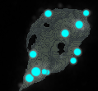
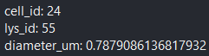
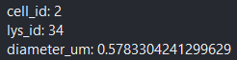
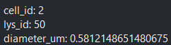
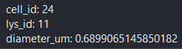
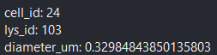
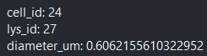
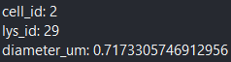
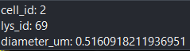
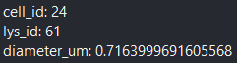
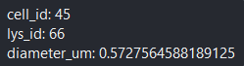
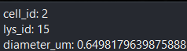
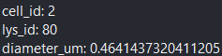
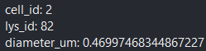
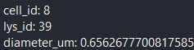
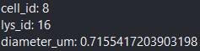
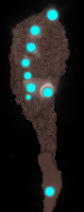
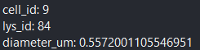
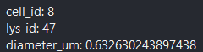
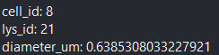
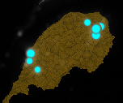
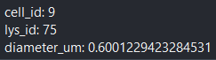
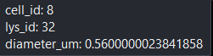
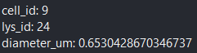
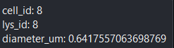
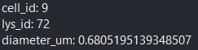
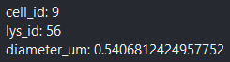
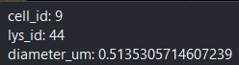
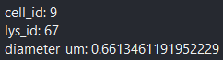
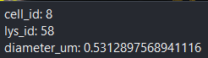
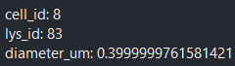
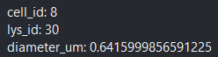
TMEM-HA 6h CB airy_3_170722

Slide 6
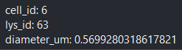
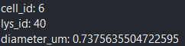
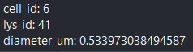
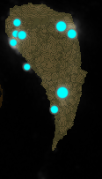
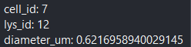
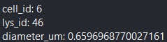
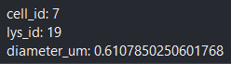
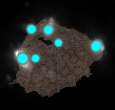
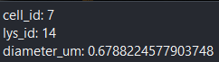













TMEM-HA 6h CB airy_3_170722

Slide 7


























TMEM-HA 6h CB airy_3_170722

Slide 8





TMEM-HA 6h CB airy_3_170722

Slide 9

40A_UAS-TMEM192-3xHA x 40A 71G10 MARCM_around 12h - for quantification_4 Airy-CBs_300425

Slide 10

40A_UAS-TMEM192-3xHA x 40A 71G10 MARCM_around 12h - for quantification_4 Airy-CBs_300425
lys_id:2
lys_id:1
lys_id:3

Slide 11




40A_UAS-TMEM192-3xHA x 40A 71G10 MARCM_around 12h - for quantification_4 Airy-CBs_300425

Slide 12

40A_UAS-TMEM192-3xHA x 40A 71G10 MARCM_around 12h - for quantification_3 Airy-CBs_300425

Slide 13

40A_UAS-TMEM192-3xHA x 40A 71G10 MARCM_around 12h - for quantification_3 Airy-CBs_300425

Slide 14





















40A_UAS-TMEM192-3xHA x 40A 71G10 MARCM_around 12h - for quantification_3 Airy-CBs_300425

Slide 15




40A_UAS-TMEM192-3xHA x 40A 71G10 MARCM_around 12h - for quantification_3 Airy-CBs_300425

Slide 16

40A_UAS-TMEM1923x-HA x 71G10 40A MARCM_L3_1_Airy_010724

Slide 17

40A_UAS-TMEM1923x-HA x 71G10 40A MARCM_L3_1_Airy_010724

Slide 18




40A_UAS-TMEM1923x-HA x 71G10 40A MARCM_L3_1_Airy_010724
1
3
2
4
10
9
7
11
12
8
6
5

Slide 19

40A_UAS-TMEM1923x-HA x 71G10 40A MARCM_L3_1_Airy_010724

Slide 20




40A_UAS-TMEM1923x-HA x 71G10 40A MARCM_L3_1_Airy_010724

